Slide 1
CAR T-Cell Therapy
Challenges in Developing and Commercialising CAR T-Cell Therapies: Key Industry Players
Issy Rahim
Notes:
Issy Rahim, born and raised in London, currently living in Wembley
Completed a BSc in Pharmaceutical Sciences in 2019
Completed a MSc in Drug Discovery and Pharma Management 2020
Management consultant, 3.5 years of experience strategically advising top 20 Pharma Companies
•Expertise in commercialisation, R&D, and Competitive Intelligence

Slide 2
Presentation Outline
1
2
3
Overview of CAR T-Cell Therapy
Commercial challenges in Development and Manufacture
Competitive Intelligence and Key Recommendations

Slide 3
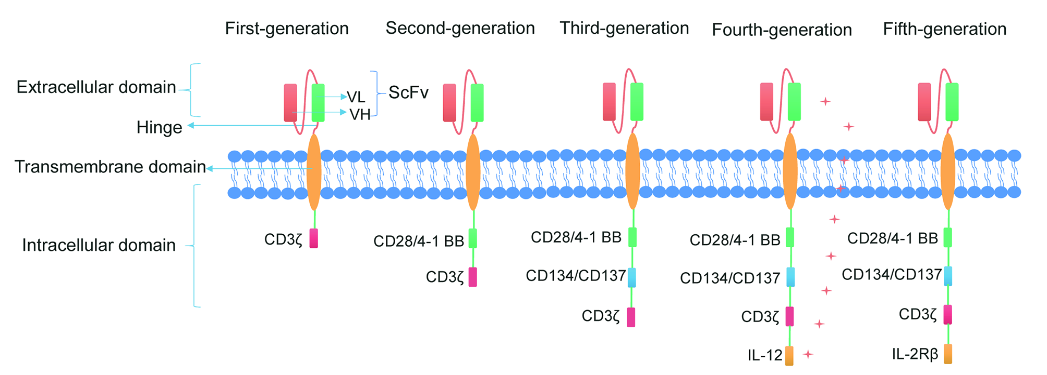











Overview of CAR T-Cell Therapy
Introduction
Target Cancers
Chimeric Antigen Receptor (CAR) T-Cell Therapy is an immunotherapy for blood cancers approved for use in 2017^{[1]}
Remarkable efficacy with complete remission (CR) rates of 60-80% reported in some clinical trials for B-cell malignancies^{[2]}
Significant incidence of side effects including cytokine release syndrome (CRS) in 37-93% of patients^{[3]} and neurotoxicity in 18-42% of patients^{[4][5]}
RWE remission in 80-90% of patients; approximately 50% of those experience a relapse within 12 months^{[6]}.
Non-Hodgkin Lymphoma (NHL)
80,350
66,890
Leukaemia (all types combined)
36,110
23,690
22,010
Multiple Myeloma (MM)
Chronic Lymphocytic Leukaemia (CLL)
Acute Myeloid Leukaemia (AML)
9.560
8,720
6,100
Chronic Myeloid Leukaemia (CML)
Hodgkin Lymphoma (HL)
Acute Lymphocytic Leukaemia (ALL)
Key Players
Fig. 1: Five generations and MOA of CAR molecules^{[7]}
Notes:
Focus: highlight the efficacy, target areas, and epidemiological context of CAR-T cell therapies, while acknowledging the side effects and generations of CAR molecules as key components of its development landscape. Third, fourth, and fifth generations are designed to improve T cell proliferation and persistence, but they are still in trial phases.
Metrics
Total new cases expected in 2024: 253,430
Total deaths in 2024: 72,670
Average predicted increase by 2034: approximately 7-10%
Risk factors: Increasing age, Male sex, Black race, Family history, Monoclonal gammopathy of undetermined significance (MGUS).
Gender:
Most blood cancers are slightly more common in men than women.
For example, the leukaemia incidence rate is 17.9 per 100,000 for males and 11.0 per 100,000 for female
Age:
Blood cancers generally affect older adults more frequently, with some exceptions
Leukaemia is most frequently diagnosed among people aged 65-74, with a median age at diagnosis of 67 years.
The median age at death for leukaemia is 76 years.
Some subtypes, like Hodgkin Lymphoma, have a bimodal age distribution with peaks in young adults and the elderly
Race/Ethnicity:
There are disparities in access to CAR T-cell therapy:
African Americans are less likely to receive CAR T-cell therapy despite being disproportionately affected by some blood cancers like multiple myeloma
•Caucasian patients are more likely to receive CAR T-cell therapy, with 66.9% of recipients being White in a 2018 study

Slide 4












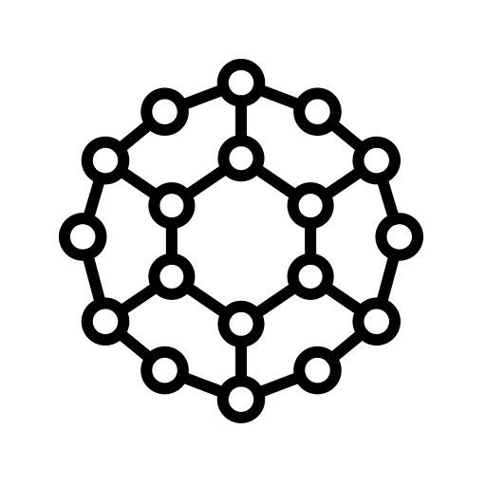

Challenges in the Development and Commercialisation of CAR T-Cell Therapy
T-Cell Collection (Leukapheresis)
Ex-Vivo Genetic Modification
Cell Expansion and Reinfusion
Gene Transfer
First Step
Last Step
Transduction
Viral vector
Static Cultures
CAR
T-Cell
Bioreactor Systems
Anti CD28 Beads
Non-viral transfection
Cultured Additives
Transfection
Nanoparticles Electroporation
Notes:
Focus: Centralised vs. Decentralised vs. Regional manufacturing sites, high-cost specialist prerequisites for development, logistical and patient transfers, complex, timely
Static culture methods:
Expansion in bags or flasks is still used, especially in the early stages of production
Some processes start with bags or flasks and then transition to RM bioreactors for final expansion
Activation agents:
Various activation methods are used during the expansion phase, including cell-, antibody-, bead-, and polymer-based activation
These agents help stimulate T cell proliferation and can influence the final composition of the CAR T cell product.
The choice of expansion method can impact the final product characteristics, including the ratio of CD4+ to CD8+ T cells and the overall functionality of the CAR T cells
Culture media and additives:
Specialised media formulations are used to support cell growth
Cytokine cocktails are added to the culture to promote T cell proliferation and maintain desired phenotypes
Bioreactor systems (Miltenyi Biotec and CliniMACS Prodigy)
Rocking motion (RM) bioreactors are commonly used, with 43% of evaluable products using this method
These systems allow for semi-automated production and can reduce labour intensity and media consumption
RM bioreactors often run in perfusion mode, which involves continuous nutrient supply and waste removal
Duration of expansion / cryopreservation:
Traditional methods typically expanded cells for about 14 days
Recent efforts have significantly shortened manufacturing time
Some processes achieving expansion in just a few days or even 1 day
Challenges with developing and commercialisation include:
Toxicities – e.g., cytokine release syndrome
Tumour resistance whereby cancer cells evade CAR-T recognition, so the therapy doesn’t work
Limited infiltration into solid tumours and issues with trafficking to tumours
Tumour microenvironment can cause issues such as immunosuppression
T cell exhaustion
Issues with transport from facilities (site) to patients
Risk of contamination
Regulatory challenges and requirements specific to CAR-T
Need for better preclinical models
Limited scalability (personalised / autologous currently)
11. Success rate is high but 50% of people relapse within 12 months

Slide 5
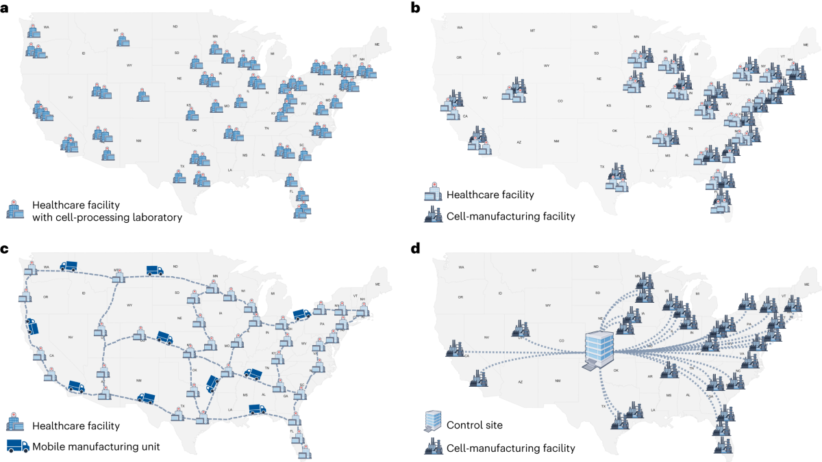
Impact of CAR-Ts on Patient Outcomes and Experience
 | Efficacy | Efficacy (CR) | Safety | Safety | Safety (Infection) | Safety (Ocular) | Accessibility |  | Convenience |  | Economics
 | ORR | CR | CRS (Gr 3+) | NTX (Gr 3+) | Infection (Gr 3+) | Ocular (Gr 3+) | Availability | Treatment location | Route of administration | Dosing frequency | Cost
CAR-T | 86% | 47% | 13% | 14% - All 3% - Gr 3+ | 13% | 0% | Manufacturing: 4-6 weeks; Limited slots | Specialised medical centre and/or hospital | IV | Single dose | Abecma: $419,500 Carvykti: $465,000
CAR-Ts have favourable impact on efficacy, but fare low on other parameters
Remarkable single-agent efficacy profile with the highest response rates amongst novel competitors
  Induces deep and durable responses; Some even show 100% ORR
Poor safety profile with highest rates of severe (i.e., grade 3+) toxicities
Highly inaccessible and expensive.
  Efforts are being made to improve manufacturing capacity
IV is not preferred, but single-dose infusion may be more convenient
Favourable patient impact
Patient outcomes
Mid negative patient impact
Patient experience
High negative patient impact
ORR= Overall response rate; CR = Complete response; CRS = Cytokine release syndrome; NTX = Neurotoxicity.
Notes:
Focus: Centralised vs. Decentralised vs. Regional manufacturing sites, high-cost specialist prerequisites for development, logistical and patient transfers, complex, timely
Timo:
Productivity of Research & Development (R&D) has declined steadily since the 1950’s according to the number of New Molecular Entities approved by the FDA per billion USD spent on R&D
R&D costs of a new drug are currently estimated at $2.8 billion
CAR-T has an estimated 11.83 % overall probability of clinical success
•While the manufacturing costs for a tablet can be as low as $0.01, one batch of a Cell & Gene Therapy can go up to $200,000
Centralised Manufacturing
• Strengths:
• Large-scale production capabilities.
• Established protocols and quality control measures.
• Ability to produce high volumes for multiple patients.
• Weaknesses:
• Longer turnaround times due to transportation.
• Higher logistical complexities and potential delays.
• Less flexibility in responding to urgent clinical needs.
Decentralised Manufacturing
• Strengths:
• Reduced vein-to-vein time, typically around 10 days.
• Greater responsiveness to patient-specific needs.
• Potential cost reductions in ongoing operations.
• Weaknesses:
• Higher initial setup costs.
• Variability in product quality depending on local facilities.
Regional Manufacturing
• Strengths:
• Utilises CDMOs for flexibility and scalability.
• Can address capacity issues as demand increases.
• Moderate turnaround times based on CDMO efficiency.
• Weaknesses:
• Quality may vary based on the capabilities of the CDMO.
• Potentially limited by regional resource availability.
Point of Care Manufacturing
• Strengths:
• Immediate access for patients at treatment sites.
• Minimal logistical challenges due to proximity to care.
• Highly flexible; can adapt quickly to urgent clinical demands.
• Weaknesses:
• Limited production capacity based on hospital resources.
• May require significant investment in infrastructure.

Slide 6
Analysis of the Current Competitive Landscape
August 2017
*** Kymriah
(tisagenlecleucel)
↑CR 65% in NHL/DLBCL/FL
Novartis
July 2020
*** Tecartus
(brexucabtagene autoleucel)
↔CR 52% in B-ALL
Kite Pharma/Gilead
February 2022
*** Carvykti
(ciltacabtagene autoleucel)
↑CR 78% in MM
Janssen Biotech / J&J
No ‘new’ approvals for 3 years
2015
2025
February 2021
**/*** Breyanzi
(lisocabtagene maraleucel)
↔CR 54% in NHL/DLBCL
Juno/Bristol Myers Squibb
March 2021
*** Abecma
(idecabtagene vicleucel)
↓CR 39% in MM
Bluebird/Bristol Myers Squibb
October 2017
**/*** Yescarta
(axicabtagene ciloleucel)
↔CR 51% in NHL/DLBCL
Kite Pharma/Gilead
November 2024
*** Aucatzyl
(obecabtagene autoleucel)
↔CR 55% in B-ALL
Autolus
CD19 target
BCMA/TNF-RSF17 target
** Second-Line Treatment after previous treatment; immunomodulatory agent (ADC), proteasome inhibitor (PI), anti-CD38 monoclonal antibody (mAb)
*** Third-Line Treatment after previous treatment; two prior lines of systemic therapy; bruton tyrosine kinase (BTK) inhibitor.
Notes:
Focus: To effectively compare the various therapies, we will include data on market size, the number of patients treated, their respective success rates, and pricing, thereby providing a comprehensive overview of their utilisation and effectiveness. All listed therapies use 2nd generation CARs with CD3ζ and either 4-1BB or CD28 co-stimulatory domains.
NHL / Diffuse Large B-cell Lymphoma (DLBCL):
Kymriah
Yescarta
Breyanzi
Multiple Myeloma (MM):
Abecma
Carvykti
B-cell Acute Lymphoblastic Leukaemia (B-ALL):
Kymriah
Tecartus
NHL / Mantle Cell Lymphoma (MCL):
Tecartus
NHL / Follicular Lymphoma (FL):
Yescarta
---
Kymriah
2nd-line for B-ALL, 3rd-line for DLBCL (a type of NHL)
CD19-directed CAR T-cell therapy. FDA approved.
475,000
Yescarta
2nd-line for NHL, 3rd-line for Follicular Lymphoma (a type of NHL)
CD19-directed CAR T-cell therapy. FDA breakthrough therapy designation for DLBCL, FL, and PMBCL.
373,000
Tecartus
2nd-line or later for MCL (a type of NHL), 3rd-line for B-ALL
CD19-directed CAR T-cell therapy. First FDA-approved for MCL. Orphan drug designation.
373,000*
Breyanzi
2nd-line for DLBCL, 3rd-line for CLL and SLL (types of NHL)
CD19-directed CAR T-cell therapy. FDA expanded boxed warning in 2024 for T cell malignancies.
410,300
Abecma
3rd-line or later for Multiple Myeloma (MM)
BCMA-directed CAR T-cell therapy. FDA breakthrough therapy and orphan drug designations.
419,500
Carvykti
3rd-line for NHL / BCMA-directed therapy
BCMA-directed CAR T-cell therapy. FDA priority review designation.
465,000*

Slide 7
The Future Competitive Landscape for New Clinical Assets in Development
Today
Abecma/bb2121 has gained FDA-approval for RRMM
One of the first CAR T-cell therapies available for MM patients
Some patients have shown ongoing clinical responses at 6 months post-treatment
Low rates of grade 3/4 CRS (6.5%) were observed
Grade 3/4 neurotoxicity was rare, occurring in only 1.6% of patients
Honorable mentions: KYVERNA, ALLOGENE/ARBOR, ROCHE
KYV-101, FDA has granted IND clearance for a Phase 2 trial (KYSA-6) and (KYSA-1) in myasthenia gravis and lupus nephritis
ALLO-316 TRAVERSE P1 trial, metastatic renal cell carcinoma
ALLO-329 dual CAR-T CD19/CD70 target, no lymphodeletion, IND clearance and plans to initiate a Phase 1 trial in mid-2025
Roche has acquired Poseida Therapeutics on 26/Nov/24 for $1.5B to expand into allogeneic off-the-shelf cell therapy in Neuro.
Notes:
Focus: Competitive Landscape
Methodology:
I sourced my data from clinicaltrials.gov
Applied a filter that showed results for: CAR T cell therapy | drugs | Active, not recruiting studies | Phase: Phase 2, 3 | Interventional studies
I decided not to focus on early phase 1 and phase 1 recruiting studies due to orphan drug designations, difficulty in sourcing patients
It highlighted 44 studies
I further filtered down for ONLY NEW drugs being developed
•This narrowed it down, I then used the following 10 criteria to manipulate the data
Criteria for analysis:
1. Drug candidate
2. National Clinical Trials (NCT)
3. Name of the study
4. Mechanism of Action (MoA)
5. Study Start (Actual)
6. Study Completion (Estimated)
7. Clinical Trial phases
8. Primary and secondary endpoints (OS, PFS, ORR)
9. Name of the company sponsor
10. Main country of origin (FDA, EMA, MHRA)
Abecma / Idecabtagene vicleucel (ide-cel, bb2121)
FDA Approval
March 26, 2021
Indication
Adult patients with relapsed or refractory multiple myeloma after four or more prior lines of therapy, including an immunomodulatory agent, a proteasome inhibitor, and an anti-CD38 monoclonal antibody
Efficacy (KarMMa trial)
Overall Response Rate (ORR): 75.8%
Very Good Partial Response (VGPR) or better: 64.5%
Complete Response (CR) or stringent CR (sCR): 38.7%
Median duration of response: 10.3 months
Median progression-free survival (PFS): 8.8 months
Median overall survival (OS): 34.2 months
Safety Profile
Grade 3/4 Cytokine Release Syndrome (CRS): 6.5%
Grade 3/4 neurotoxicity: 1.6%
Biomarkers
Ide-cel expansion in blood and bone marrow correlated with clinical efficacy
Post-infusion reduction of soluble BCMA associated with response
Ongoing Clinical Trial
NCT05032820
Combination therapy
Phase 2 trial testing bb2121 in combination with lenalidomide for multiple myeloma patients with sub-optimal response after autologous hematopoietic cell transplantation and maintenance lenalidomide
IMiDs = Immunomodulatory Drugs
E.g., Lenalidomide, Pomalidomide, Thalidomide
MoA = Modulate immune response by inhibiting tumor necrosis factor-alpha (TNF-α) and block angiogenesis through the inhibition of vascular endothelial growth factor (VEGF)
Other:
AstraZeneca has successfully completed its acquisition of Gracell Biotechnologies Inc., a clinical-stage biopharmaceutical company
The deal, valued at approximately USD 1.2 billion, was finalised in early 2024
A Phase 1b/2 Study of GC012F (AZD0120), a Chimeric Antigen Receptor T-cell (CAR T) Therapy Targeting CD19 and B-cell Maturation Antigen (BCMA) in Subjects with Relapsed/Refractory Multiple Myeloma

Slide 8
Conclusions and Recommendations
Major Challenges
CAR-Ts expected to dominate sales by 2028
Unmet needs exist in the outcomes and experience of heavily pre-treated patients:
Multiple myeloma market size expected to be $35 billion by 2028
CAR-Ts expected to dominate sales by 2028, followed by BsAbs, and then ADCs
Better safety profile
Convenience
(route of administration)
Accessibility
(location)
Cost-effectiveness
Overcoming resistance mechanisms
Fig. 2: Global sales by modality in 2028
Source: Evaluate Pharma
CAR-Ts
BsAbs
ADCs
Future recommendations and strategies to address unmet needs
Strategy
Why?
Introduction in Earlier Treatment Lines | Overcome resistance, improve response depth
Combination therapies (e.g., IMiDs, PIs, mAbs) | Overcome resistance, enhance treatment durability
Advanced Antigen Targeting | Overcome resistance, improve treatment efficacy
Enhanced Safety Profile | Improved tolerability for side effects, broaden eligibility
Precision Cost Reduction | Decrease economic barrier for access
Expanding Therapeutic Applications | Unmet need for better solid tumour therapies
Allogeneic Cell Sourcing | More widely available and off the shelf, increase accessibility
Notes:
The future is Allogeneic, In-Vivo (less exhausted T-cell) Therapy, Neurology and Rheumatology
IMiDs = Immunomodulatory Drugs
E.g., Lenalidomide, Pomalidomide, Thalidomide
MoA = Modulate immune response by inhibiting tumor necrosis factor-alpha (TNF-α) and block angiogenesis through the inhibition of vascular endothelial growth factor (VEGF)
PIs = Protease Inhibitors
Example drugs = Nelfinavir, Atazanavir, Ritonavir, Saquinavir (oral)
MoA = Inhibit cellular proteases, reduce angiogenesis by decreasing VEGF production, and induce endoplasmic reticulum stress leading to cancer cell death
mAbs = Monoclonal Antibodies
Example drugs = Rituximab, Trastuzumab, Pembrolizumab
MoA = Bind specifically to target antigens on cancer cells, activate immune responses (e.g., ADCC), and block signalling pathways crucial for cancer cell survival and proliferation
BsAbs = Bispecific Antibodies
Example drugs = Blinatumomab, Catumaxomab, Emicizumab
MoA = Target two distinct antigens simultaneously, typically one on cancer cells and one on immune cells, bridging them to enhance anti-tumor immune responses
ADCs = Antibody-Drug Conjugates
Example drugs = Trastuzumab emtansine, Brentuximab vedotin, Enfortumab vedotin
MoA = Selectively deliver cytotoxic payloads to cancer cells via receptor-mediated endocytosis, releasing the cytotoxic agents inside cancer cells
Introduction in earlier lines
To potentially improve outcomes by using CAR T-cell therapy before patients become heavily pretreated and refractory to multiple therapies.
Combination therapies (e.g., IMiDs, PIs, mAbs)
To enhance anti-tumor effects, overcome immunosuppressive microenvironments, and potentially improve durability of response.
Advanced Antigen Targeting
To address tumor heterogeneity, reduce the risk of antigen escape, and improve overall efficacy and reduce relapse rates.
Enhanced Safety Profile
To reduce severe side effects like cytokine release syndrome and neurotoxicity, making the therapy more tolerable and accessible to a broader patient population.
Precision Cost Reduction
To make CAR T-cell therapy more accessible by optimizing manufacturing processes and exploring off-the-shelf options.
Expanding Therapeutic Applications
To extend the benefits of CAR T-cell therapy beyond hematological malignancies, potentially addressing solid tumors and other cancer types
Allogeneic Cell Sourcing
To create "off-the-shelf" products from donor T-cells, potentially reducing production time and costs while increasing accessibility.
To unlock the full potential of CAR T, investment is necessary in four areas:
optimizing autologous CAR Ts for liquid tumors,
expanding the number of healthcare settings that administer CAR T
shortening the innovation cycle time to enable success in solid tumors
and innovating in the manufacturing of next-generation CAR T-cell therapies.
In the inpatient setting, the current diagnosis-related group payment is insufficient to cover the cost of CAR T care. Even with the outlier and new technology add-on payments (NTAP), hospitals have stated that they are expected to take a net loss on Medicare patients treated with CAR T

Slide 9
References
[1] https://pmc.ncbi.nlm.nih.gov/articles/PMC10225594/
[2] https://www.sciencedirect.com/science/article/pii/S000649712409373
[3] https://pubmed.ncbi.nlm.nih.gov/33708205/
[4] https://www.nature.com/articles/s41408-022-00629-1
[5] https://aacrjournals.org/cancerdiscovery/article/8/8/958/10154/Clinical-and-Biological-Correlates-o
[6] https://pmc.ncbi.nlm.nih.gov/articles/PMC10786140/
[7] https://cancerci.biomedcentral.com/articles/10.1186/s12935-024-03315-3
[8] https://www.frontiersin.org/journals/molecular-medicine/articles/10.3389/fmmed.2024.1310002/ful
[9] https://pmc.ncbi.nlm.nih.gov/articles/PMC9043864/
[10] https://cancerci.biomedcentral.com/articles/10.1186/s12935-024-03315-3
[11] https://www.aucatzylhcp.com/
[12] https://kyvernatx.com/platform-pipeline/
[13] https://allogene.com/

